Slide 1
Trending Videos
A statistical analysis by Muduo Wang

Slide 2
Variables
Categories of Videos
Hours between Publishing and Trending
Views
Likes
Comments

Slide 3
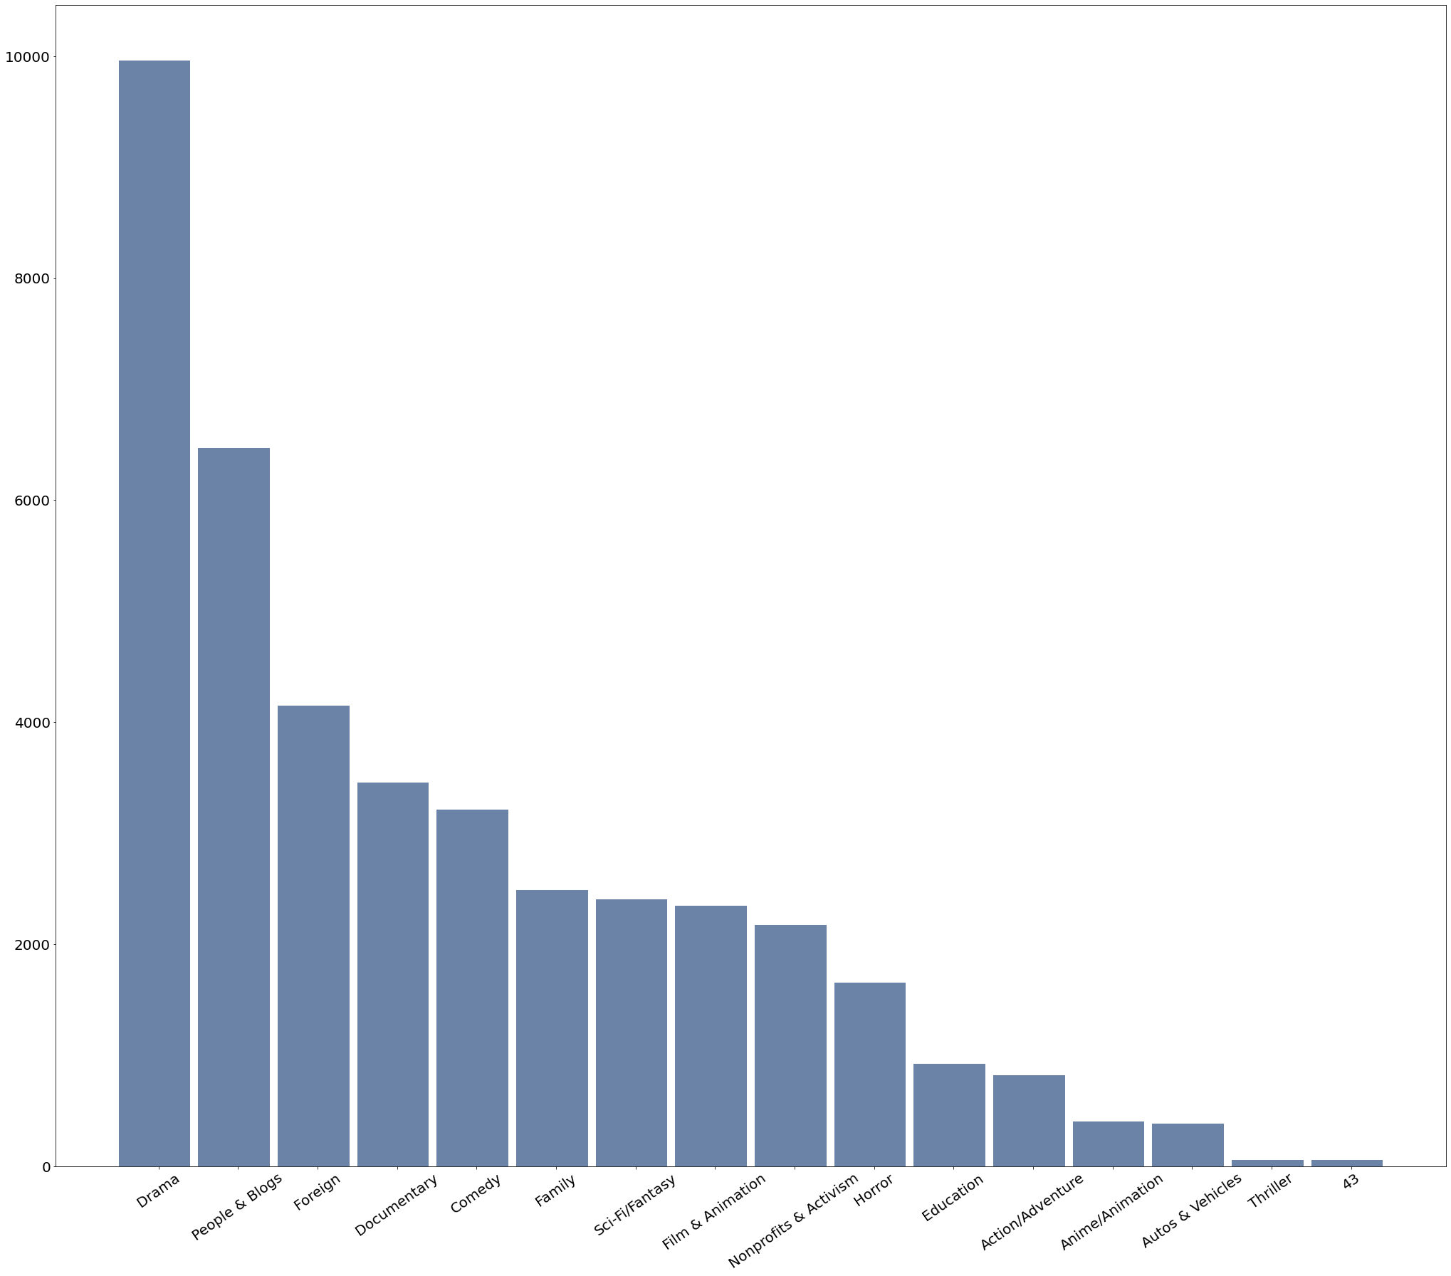
Categories
The categories of the videos

Slide 4
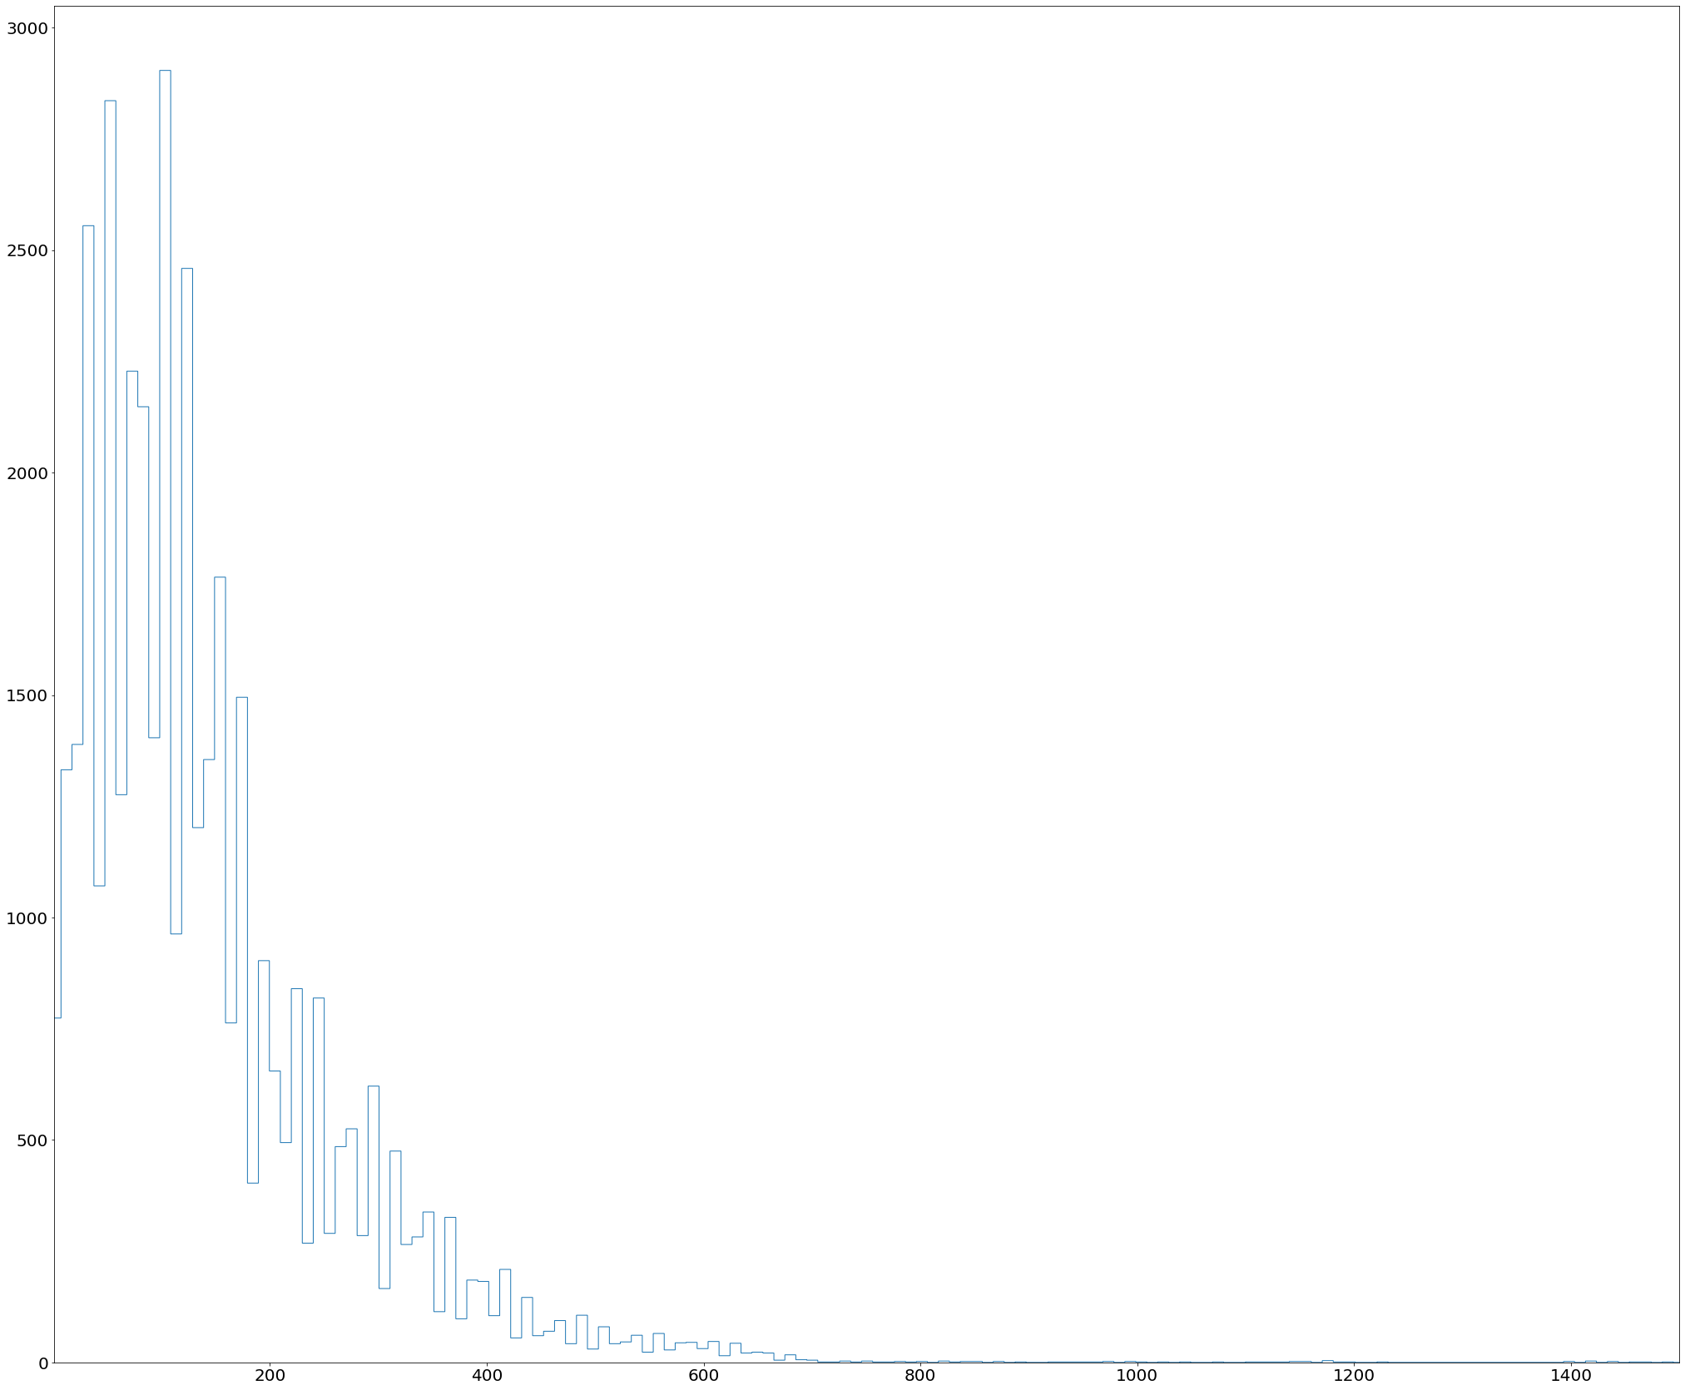
Hours to Fame
Hours passed between publish time and trending time (500+views)
Mean: 389.3593250140419
Standard Deviation: 3504.2747763407024
Kurtosis: 305.83992656839524
Mode:
80

Slide 5
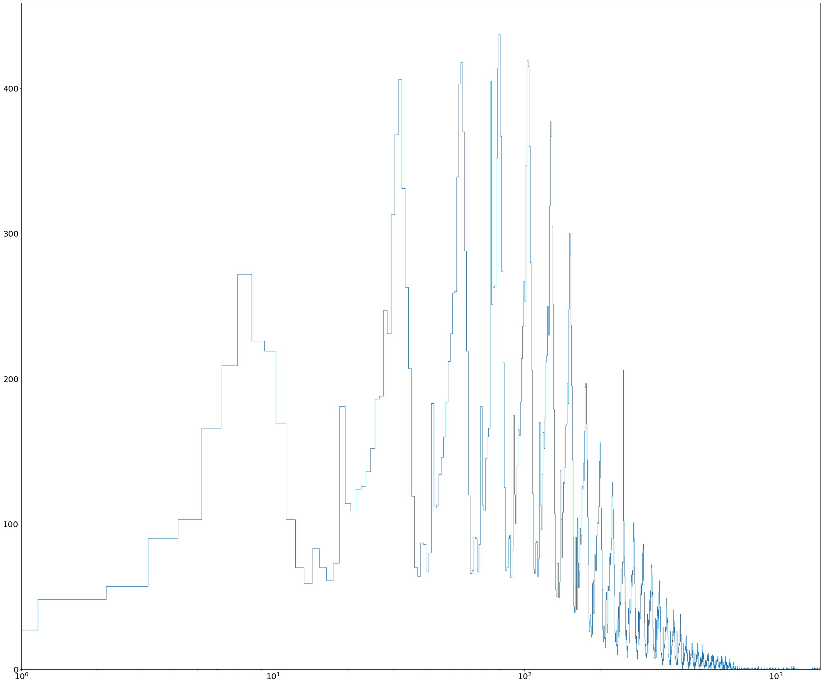
Log- transformed Hours to Fame

Slide 6
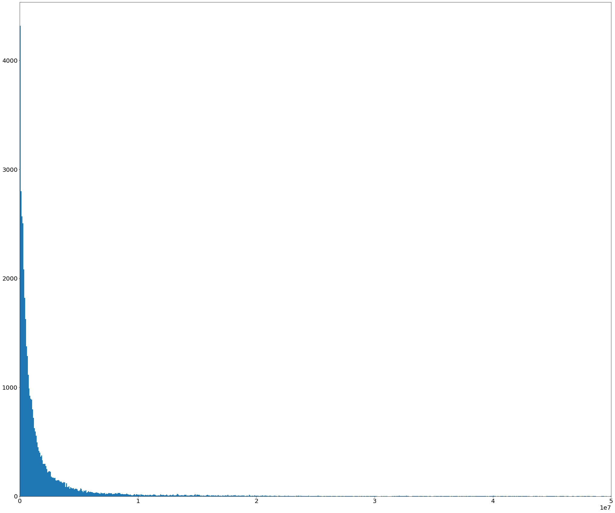
Views of Videos
Mean: 2360784.6382573447
Standard Deviation: 7394023.474728702
Kurtosis: 232.35173409707284
Mode:
3000

Slide 7
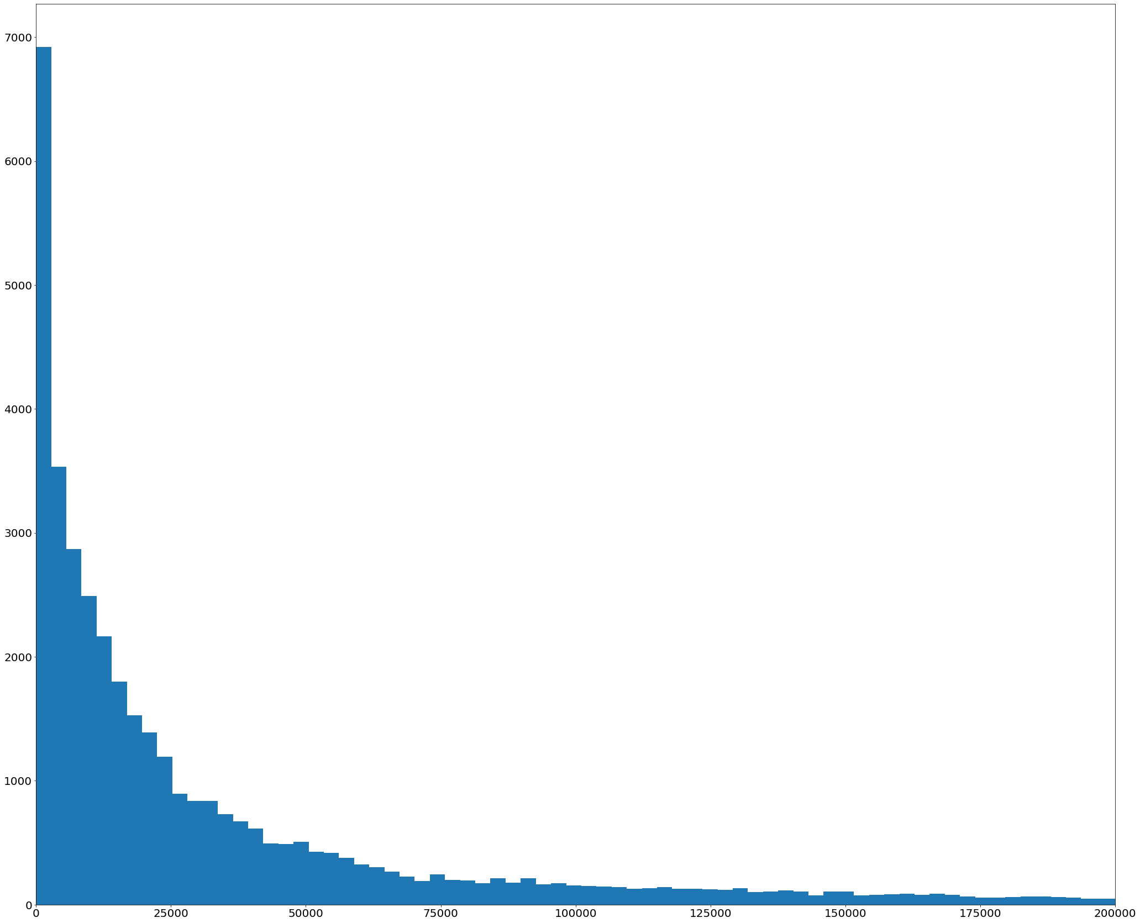
Likes
Mean: 74266.7024347359
Standard Deviation: 228882.54343141406
Kurtosis: 177.82522243126917
Mode:
0 (yep)

Slide 8
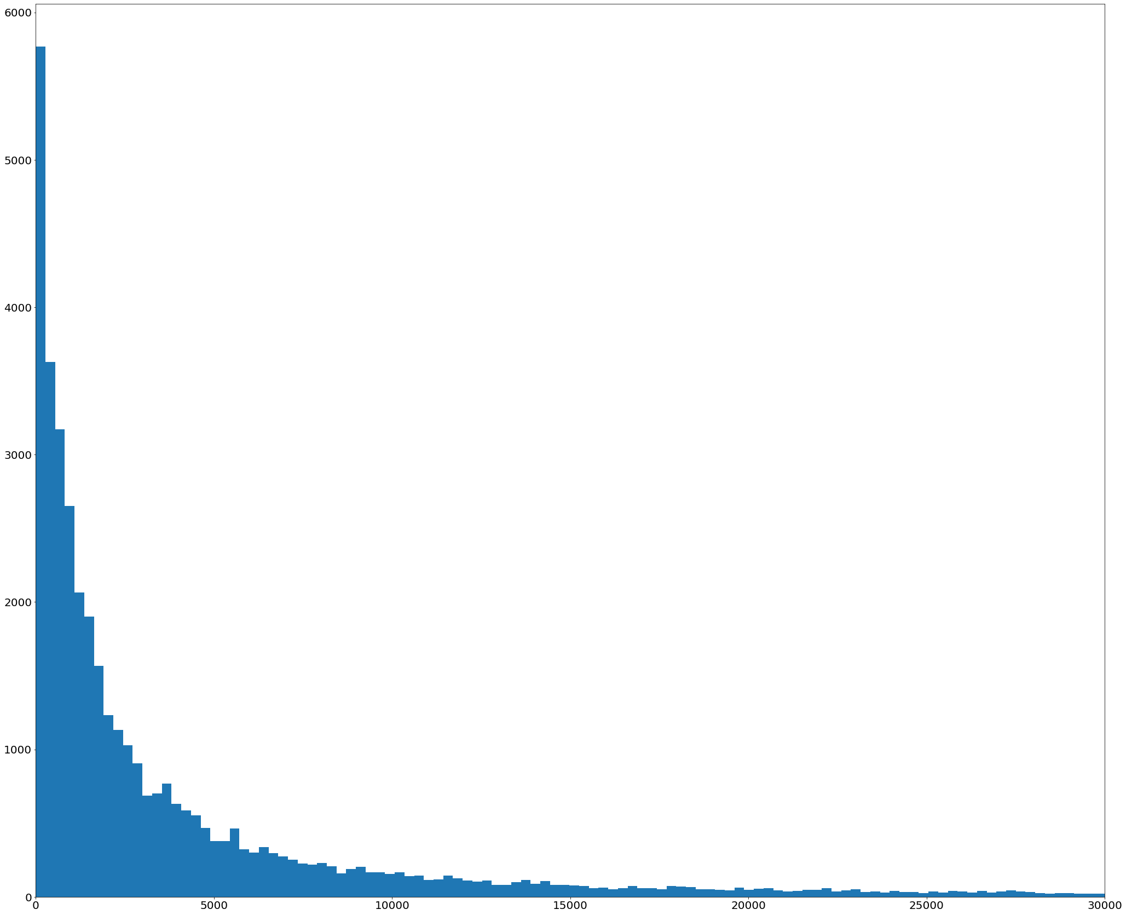
Totals Comments
Mean: 8446.803682629612
Standard Deviation: 37430.029953725374
Kurtosis: 532.0790635194425
Mode:
0 (again)

Slide 9
Outliers
There are no real outliers to any of the data.
Besides one thing:
In the histograms, The tails are extremely long and have extremely low frequency
This indicates that the number of views are really high for these videos, which are very rate.

Slide 10
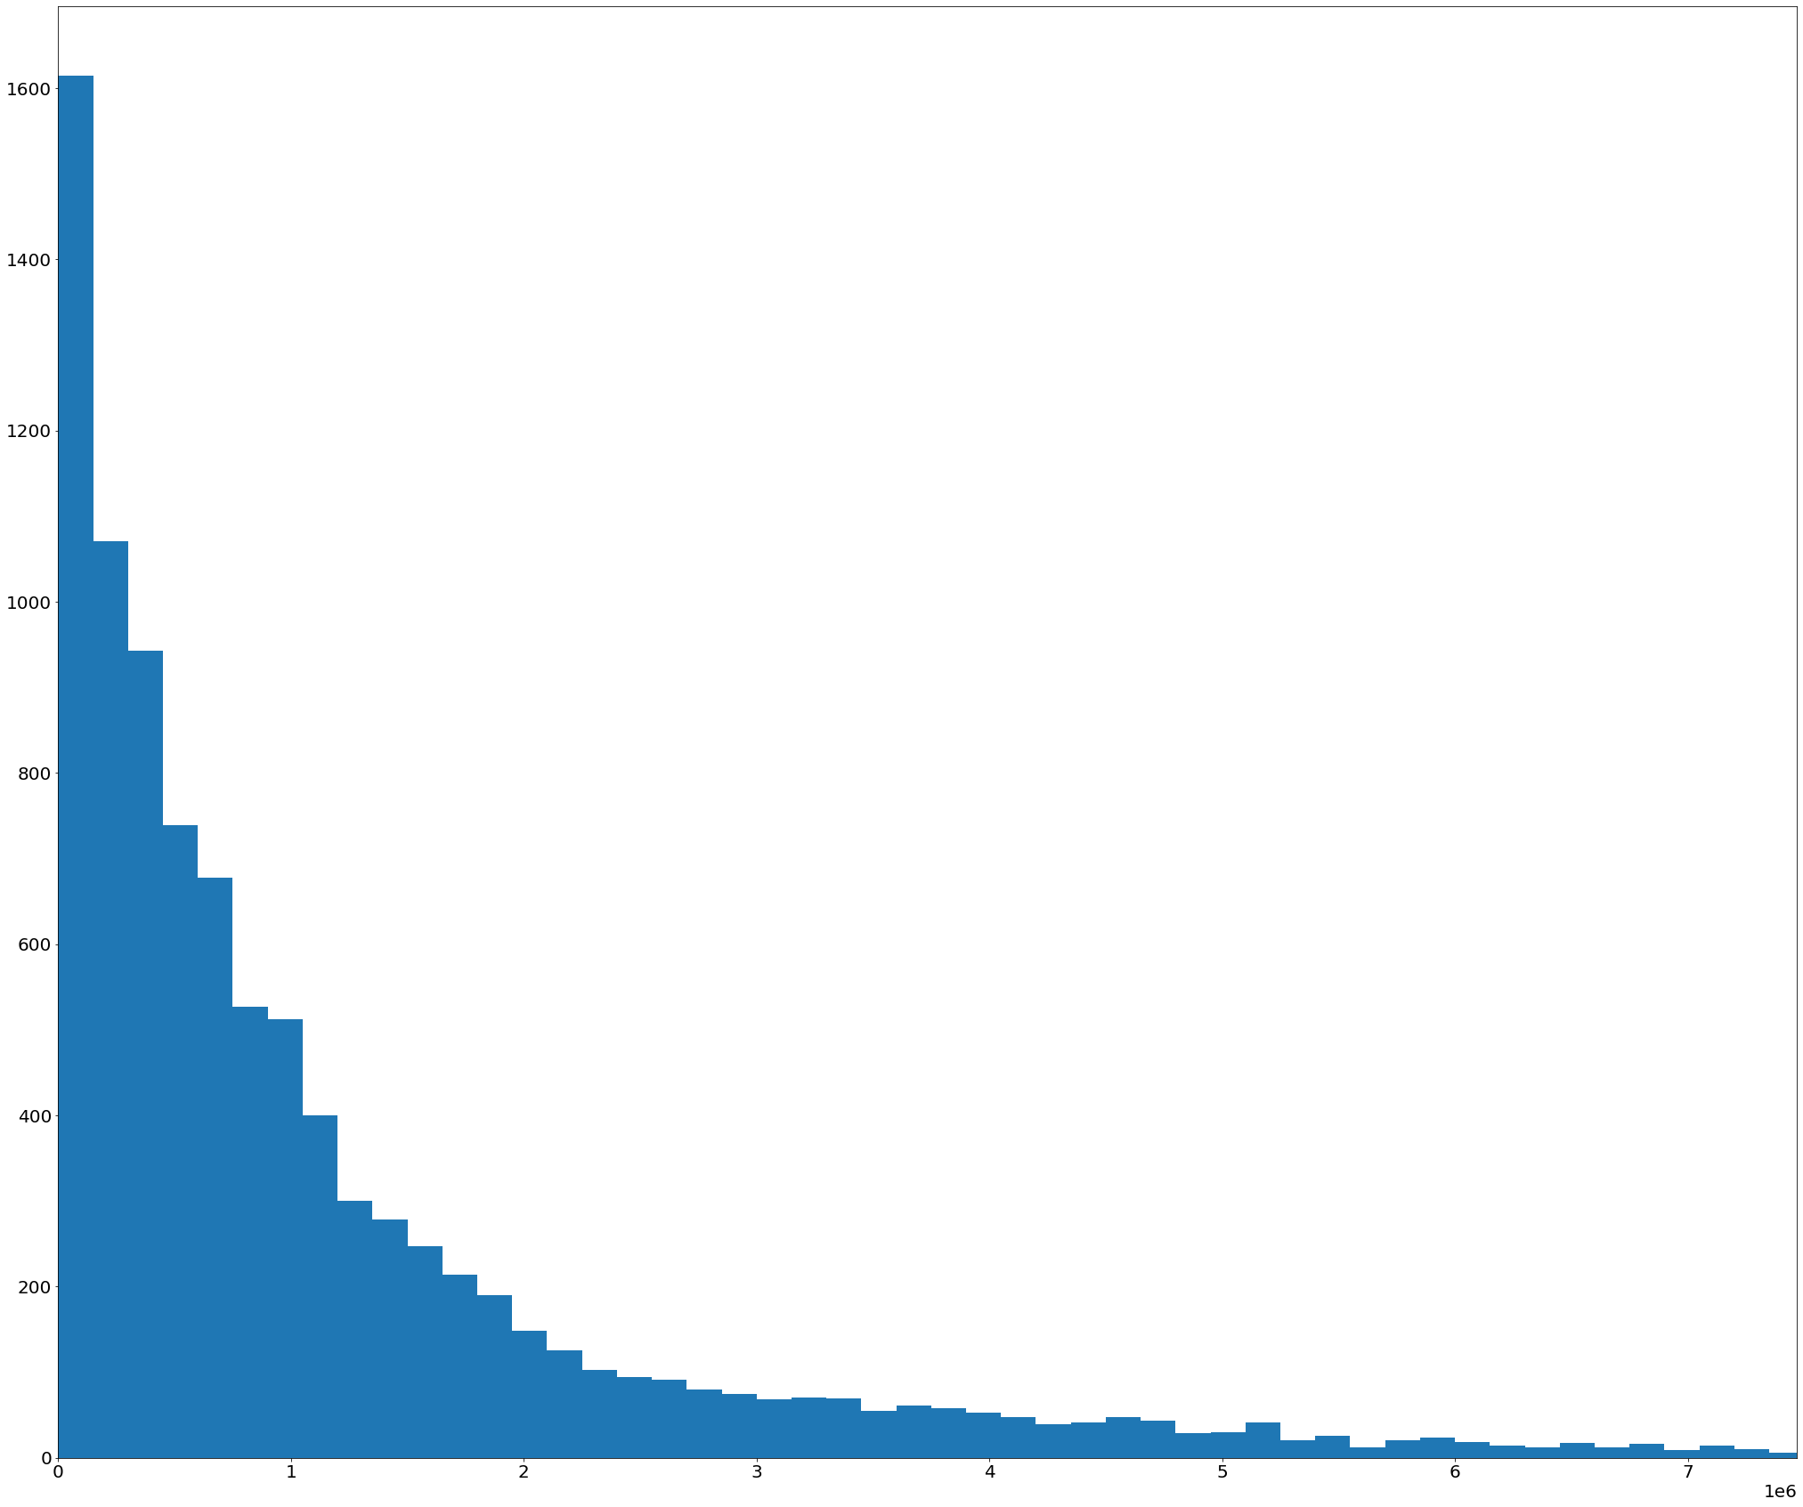
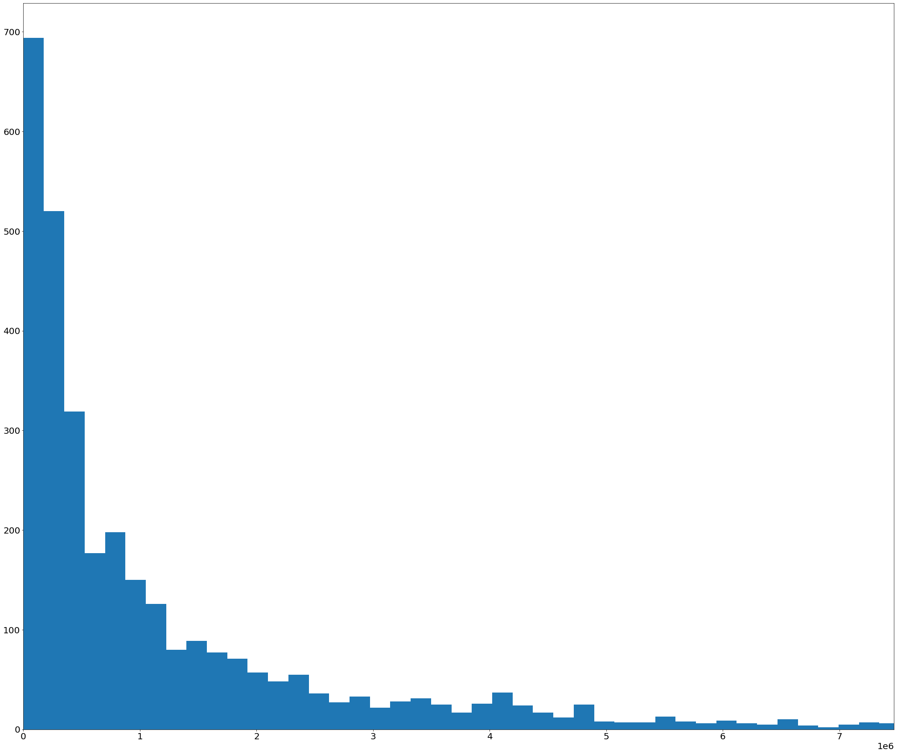
PMFs
There is no significant difference between the two, except that the PMF of Drama videos, which contains more data, follows a smoother Pareto distribution than the PMF of Comedy Videos.
PMF of Views of Drama Videos:
PMF of Views of Comedy Videos:

Slide 11
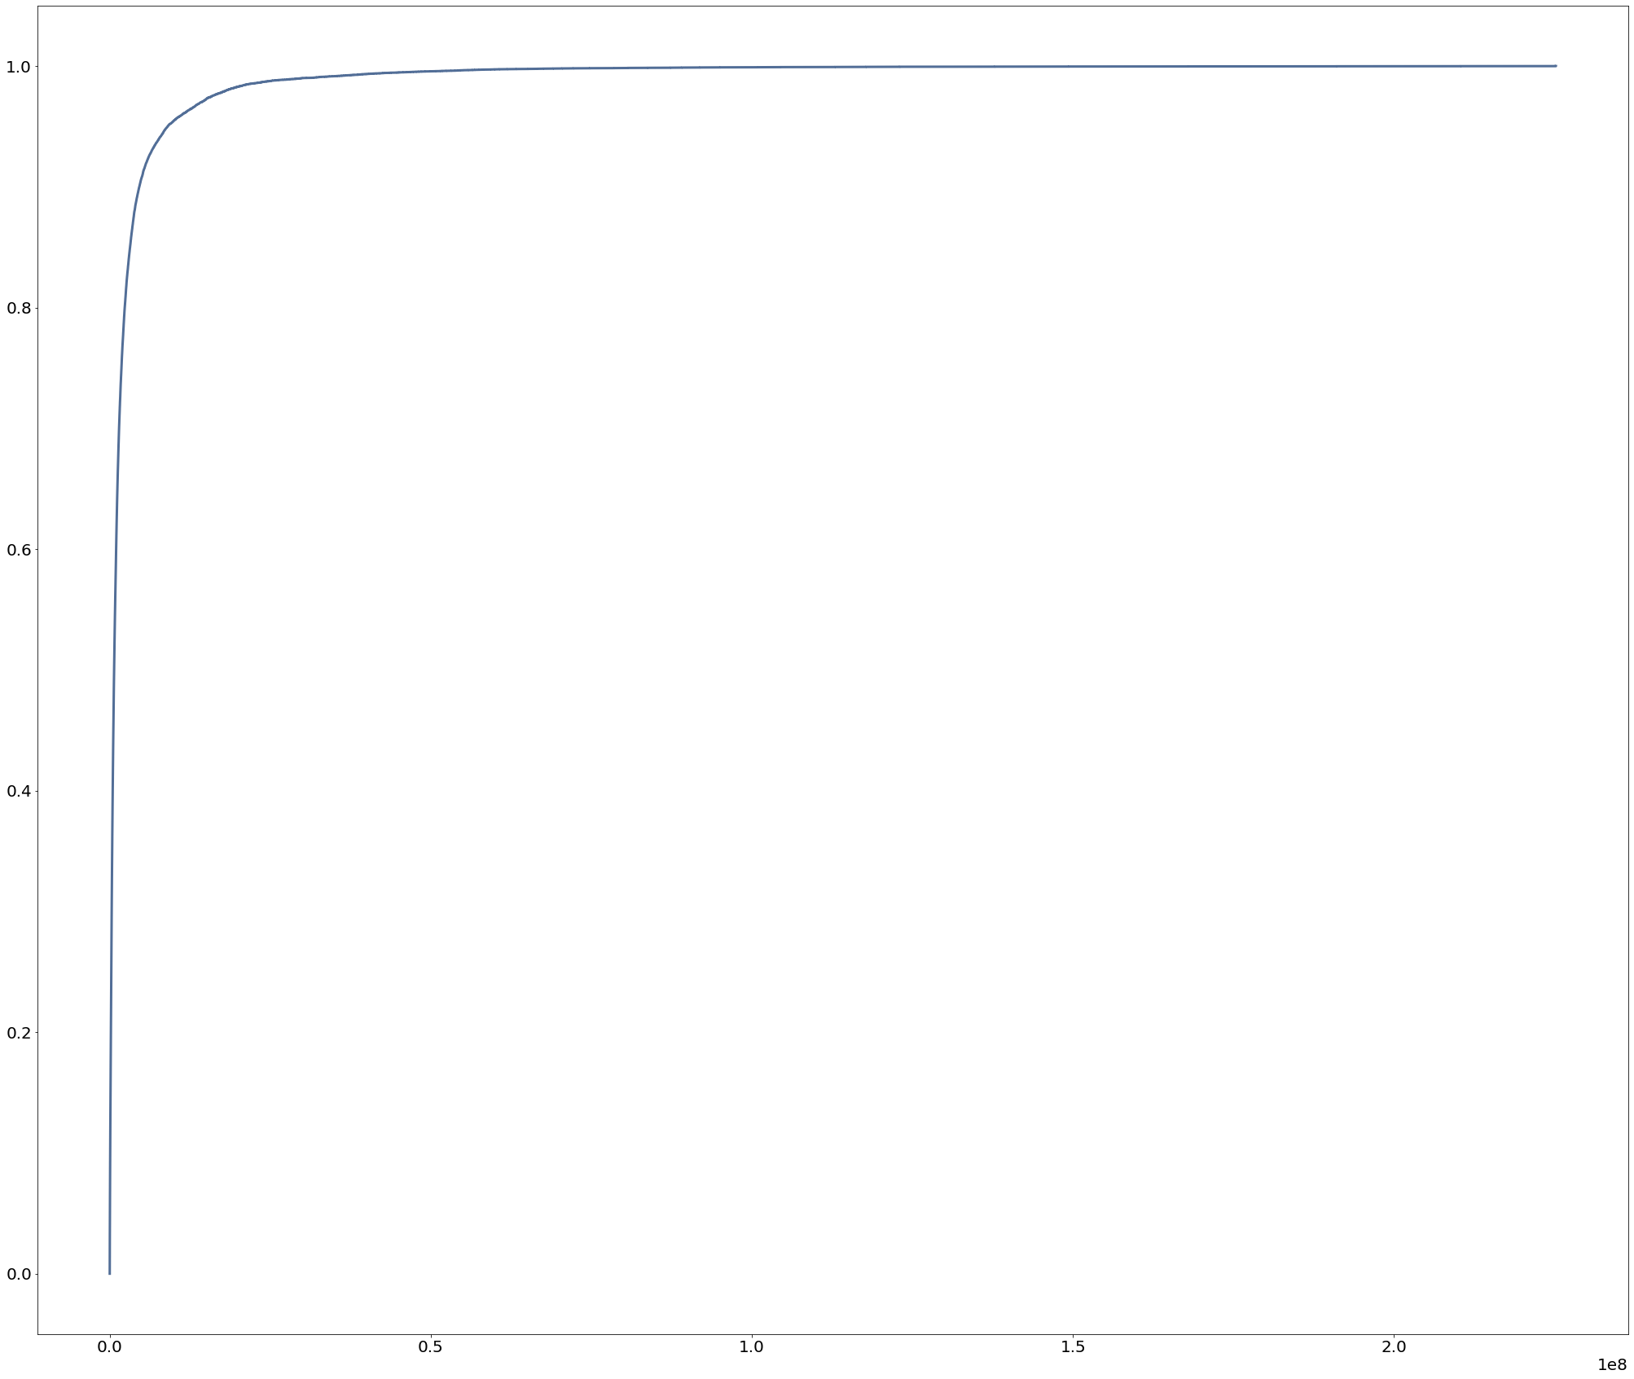
CDF of Views
Yep,
Epitome of Pareto.
This is basically exactly the Pareto line, and I'm having a hard time plotting the distribution itself, as the book doesn't explain it and there was very little resources I could find on this. However, according to the textbook, if I use the log scales for both the axis, I will get a straight line, so here it is.

Slide 12
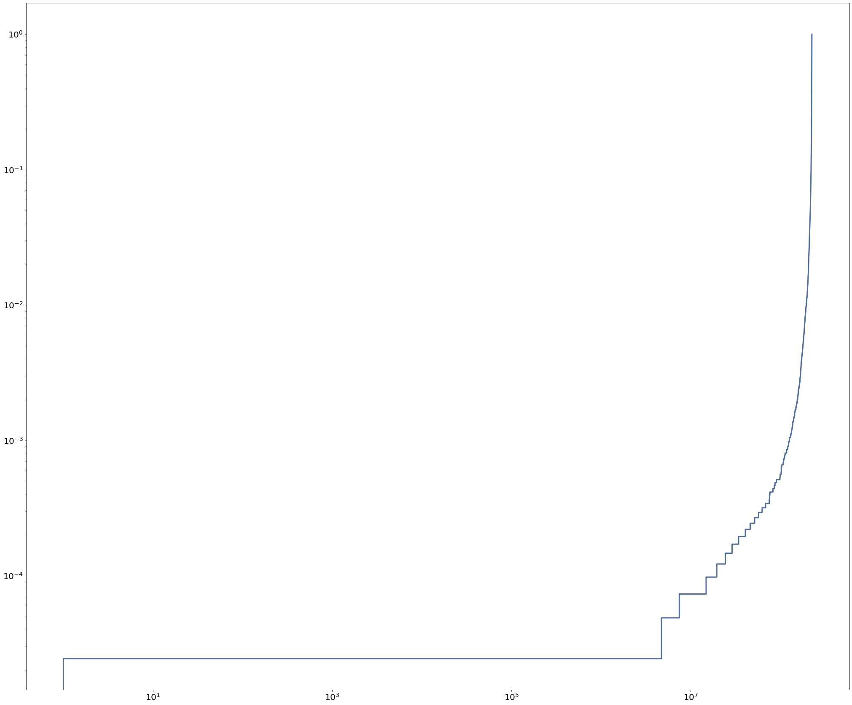
Log- transformation
This is the log-transformed view of the Complementary Cumulative Distribution Function.
If we zoom in on the middle of the dataset, the straight line can be clearly observed.
This means that only a small proportion of the videos have high views, and the majority of the video views is contributed by fewer videos.

Slide 13
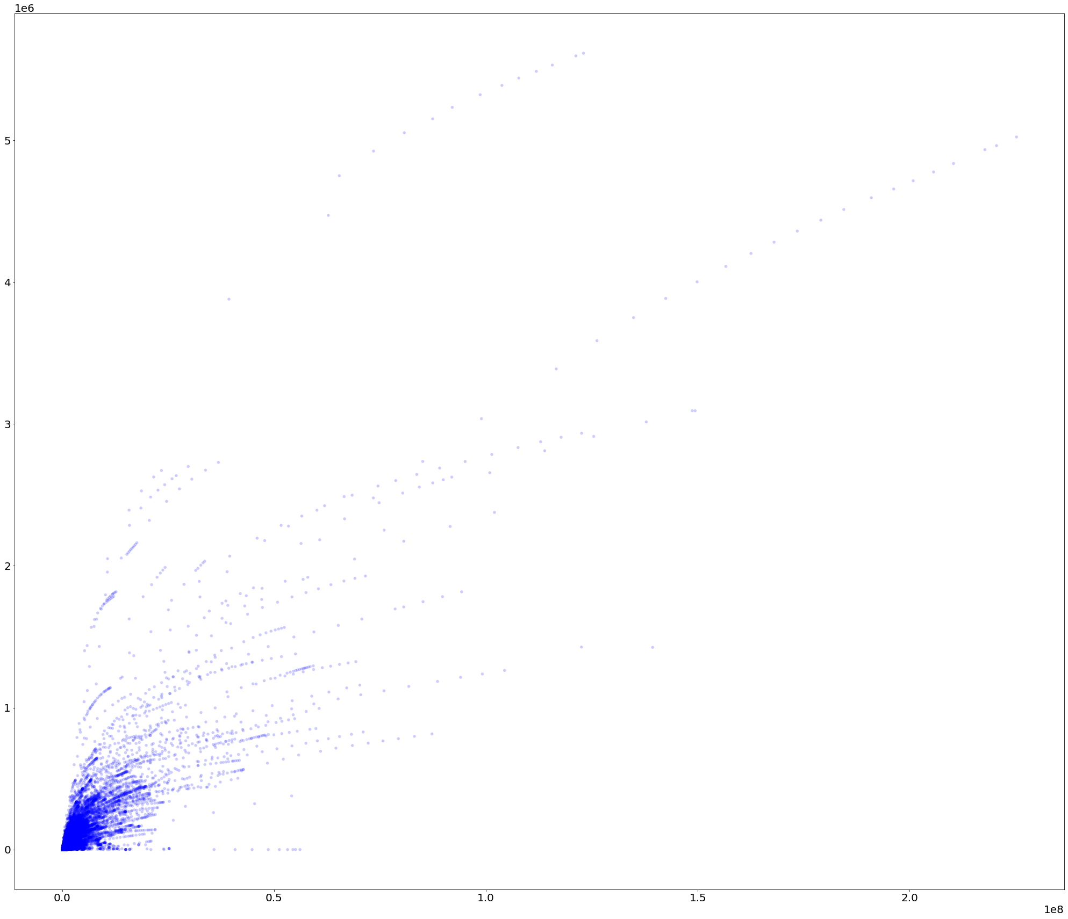
Comments and Likes
Scatter Plot
Pearson’s R 0.80305686]
Spearman’s Rank Correlation
0.878362512420941
Both P-Values both below 0.01

Slide 14
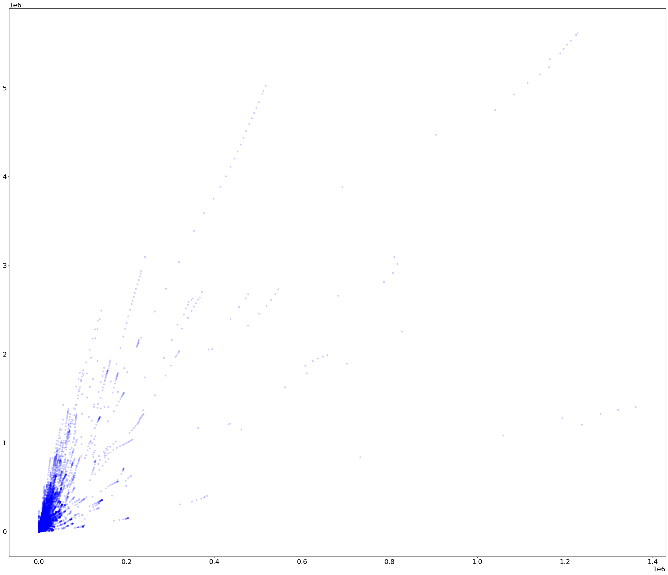
Views and Likes
Scatter Plot
Pearson’s R 0.80305686]
Spearman’s Rank Correlation
0.878362512420941
Both P-Values both below 0.01

Slide 15
Permutation Test
We will test the model with permutation.
The test results in a p-value under 0.01. Thus the null hypothesis is false. And the correlational hypothesis is true.b

Slide 16
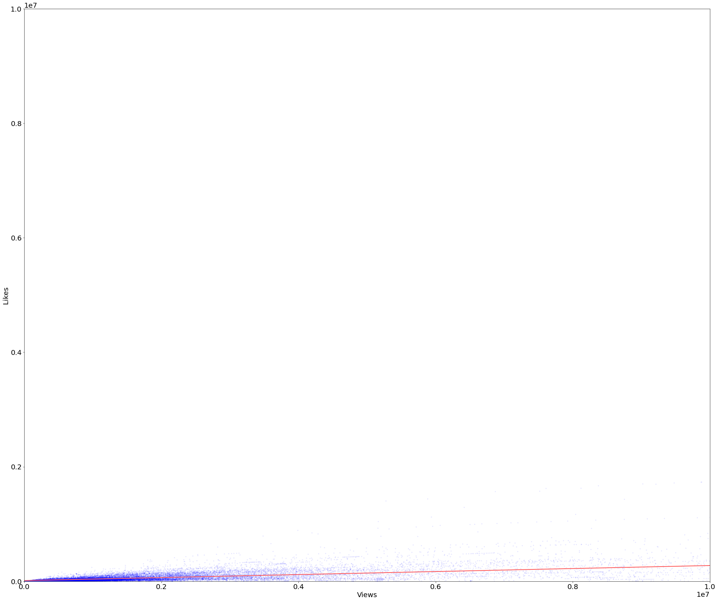
Linear Regression
Views and Likes
Note that this is test fails many assumptions, including:
Homoscedasticity
Linearity
Autocorrelation
The regression line is:
Intercept: 12210.35 (likes)
Slope: 0.026 (likes/view)

Slide 17
Thank you!

